Slide 1

Data Communication and Networking
(01IT0301)
Ch- 3 Signal Encoding Techniques
Prepared By:
Prof. Bhumi Kotak
Assistant professor, ICT Department

Slide 2
Syllabus
Signal Characteristic
Data Communication
Signal Encoding Techniques
Bandwidth Utilization: Multiplexing and Spreading
Transmission Media
Switching System and Communication Networks
Wireless WAN
Communication Technologies
Data Link Control

Slide 3
Topics:
Digital to digital Conversion
Data transmission modes
Analog to analog transmission
Digital to analog transmission.

Slide 4

Analog-to-Digital Conversion
Digital signal is superior to an analog signal. The tendency today is to change an analog signal to digital data. In this section we describe two techniques, pulse code modulation and delta modulation.
Components of PCM encoder
[1] Data Communications and Networking: Behrouz Forouzan, 4th Edition.

Slide 5
A2D Conversion: Sampling
Sampling is the process of converting analog signal into a discrete signal or making an analog or continuous signal to occur at a particular interval of time, this phenomena is known as sampling.
Sampling Theorem: Sampling theorem states that a band limited signal having no frequency components higher than fm hertz can be sampled if its sampling freq is equal to or greater than Nyquist rate.
Sampling Rate: To discretize the signals, the gap between the samples should be fixed. That gap can be termed as a sampling period Ts.
Sampling Frequency=1/Ts=fs
Where,
Ts = sampling time
  fs = sampling frequency or the sampling rate
[2] https://en.wikipedia.org/wiki/Sampling_(signal_processing)

Slide 6
A2D Conversion: Sampling
Sampling is the process of converting analog signal into a discrete signal or making an analog or continuous signal to occur at a particular interval of time, this phenomena is known as sampling.
Sampling Theorem: Sampling theorem states that a band limited signal having no frequency components higher than fm hertz can be sampled if its sampling freq is equal to or greater than Nyquist rate.
Sampling Rate: To discretize the signals, the gap between the samples should be fixed. That gap can be termed as a sampling period Ts.
Sampling Frequency=1/Ts=fs
Where,
Ts = sampling time
  fs = sampling frequency or the sampling rate
[2] https://en.wikipedia.org/wiki/Sampling_(signal_processing)

Slide 7

A2D Conversion: Sampling
[1] Data Communications and Networking: Behrouz Forouzan, 4th Edition.

Slide 8
A2D Conversion: Sampling
Sampling Techniques:
Natural Sampling: Practical method of sampling in which pulse have finite width equal to τ. Sampling is done in accordance with the carrier signal which is digital in nature.
Flat top Sampling: its like natural sampling i.e; practical in nature. In comparison to natural sampling flat top sampling can be easily obtained. In this sampling techniques, the top of the samples remains constant and is equal to the instantaneous value of the message signal x(t) at the start of sampling process. Sample and hold circuit are used in this type of sampling.
Ideal Sampling: Instantaneous sampling or Impulse Sampling. Train of impulse is used as a carrier signal for ideal sampling. In this sampling technique the sampling function is a train of impulses and the principle used is known as multiplication principle.
According to the Nyquist theorem, the sampling rate must be at least 2 times the highest frequency contained in the signal.
[3] https://blog.oureducation.in/sampling-techniques/

Slide 9

Nyquist Rate: Band limiting
Sample only band limited signal,signal with infinite bandwidth couldnot sampled
Analog signal is low pass, bandwidth = highest frequency
Analog signal is band pass,bandwidth < hughst frquency

Slide 10

A2D Conversion: Recovery
Recovery of sampled sine wave for different sampling ratee

Slide 11
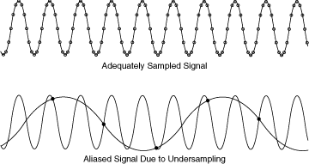
A2D Conversion: Recovery & Aliasing

Slide 12
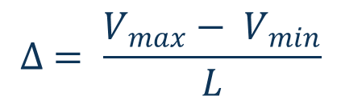
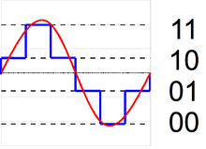
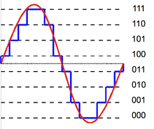
A2D Conversion: Quantization
Rounding and truncation are typical examples of quantization processes.
The difference between an input value and its quantized value (such as round-off error) is referred to as quantization error.
Step Size:
[4] https://en.wikipedia.org/wiki/Quantization_(signal_processing)

Slide 13

A2D Conversion: Quantization
[1] Data Communications and Networking: Behrouz Forouzan, 4th Edition.

Slide 14
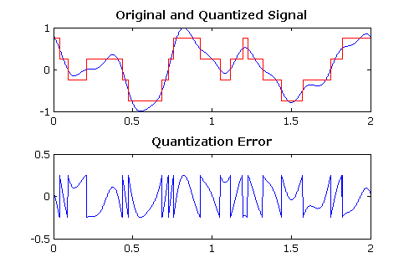
A2D Conversion: Quantization Noise
The difference between an input value and its quantized value (such as round-off error) is referred to as quantization error.
[4] https://en.wikipedia.org/wiki/Quantization_(signal_processing)

Slide 15
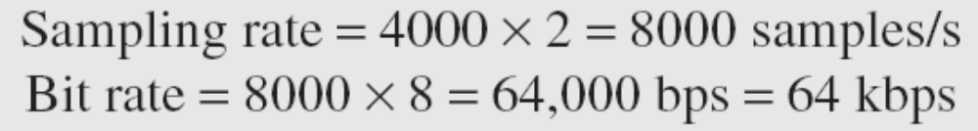
A2D Conversion: Quantization Noise
We want to digitize the human voice. What is the bit rate, assuming 8 bits per sample?
Solution
The human voice normally contains frequencies from 0 to 4000 Hz. So the sampling rate and bit rate are calculated as follows:
Bit Rate = sampling rate * number of bits per sample
[1] Data Communications and Networking: Behrouz Forouzan, 4th Edition.

Slide 16
A2D Conversion: Uniform Vs Non-uniform Quantization
Companding: companding means reducing the instantaneous voltage amplitude for large values
Expanding is the opposite process.
[1] Data Communications and Networking: Behrouz Forouzan, 4th Edition.

Slide 17

A2D Conversion: PCM Decoder
[1] Data Communications and Networking: Behrouz Forouzan, 4th Edition.

Slide 18

Delta Modulation
[1] Data Communications and Networking: Behrouz Forouzan, 4th Edition.

Slide 19

Delta Modulator Components
[1] Data Communications and Networking: Behrouz Forouzan, 4th Edition.

Slide 20

Delta demodulator Components
[1] Data Communications and Networking: Behrouz Forouzan, 4th Edition.

Slide 21

Transmission Modes
[1] Data Communications and Networking: Behrouz Forouzan, 4th Edition.

Slide 22

Parallel Transmission
[1] Data Communications and Networking: Behrouz Forouzan, 4th Edition.

Slide 23

Serial Transmission
[1] Data Communications and Networking: Behrouz Forouzan, 4th Edition.

Slide 24

Asynchronous Transmission
In asynchronous transmission, we send 1 start bit (0) at the beginning and 1 or more stop bits (1s) at the end of each byte. There may be a gap between
each byte.
Asynchronous here means “asynchronous at the byte level,” but the bits are still synchronized; their durations are the same.
[1] Data Communications and Networking: Behrouz Forouzan, 4th Edition.

Slide 25

Asynchronous Transmission
In synchronous transmission, we send bits one after another without start or stop bits or gaps. It is the responsibility of the receiver to group the bits.
[1] Data Communications and Networking: Behrouz Forouzan, 4th Edition.

Slide 26

Digital to Digital Conversion
The D2D conversion involves three techniques: line coding, block coding, and scrambling. Line coding is always needed; block coding and scrambling may or may not be needed.
Line Coding is the process of converting digital data to digital signals.
Data can be in any form of audio, video, text, numbers, graphical images, are stored in computer memory as sequences of bits.
At the sender, digital data are encoded into a digital signal; at the receiver, the digital data are recreated by decoding the digital signal.
[1] Data Communications and Networking: Behrouz Forouzan, 4th Edition.

Slide 27
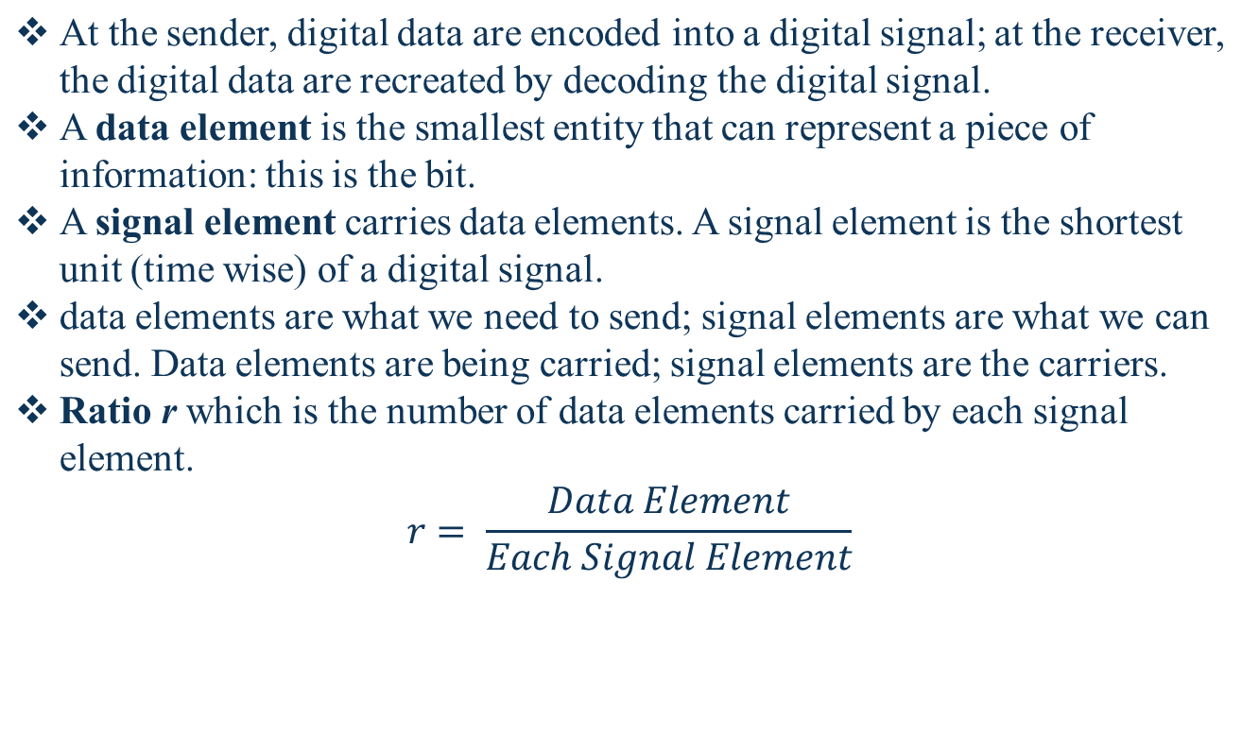
Signal Element & Data Element
[1] Data Communications and Networking: Behrouz Forouzan, 4th Edition.

Slide 28

Signal Element & Data Element
[1] Data Communications and Networking: Behrouz Forouzan, 4th Edition.

Slide 29
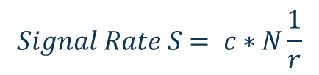
Signal Rate & Data Rate
The data rate defines the number of data elements (bits) sent in 1 second. The unit is bits per second (bps).
The signal rate is the number of signal elements sent in 1second . The unit is the baud.
The data rate is sometimes called the bit rate; the signal rate is sometimes called the pulse rate, the modulation rate, or the baud rate.
One goal in data communications is to increase the data rate while decreasing the signal rate.
Increasing the data rate increases the speed of transmission; decreasing the signal rate decreases the bandwidth requirement.
[1] Data Communications and Networking: Behrouz Forouzan, 4th Edition.

Slide 30


Signal Rate & Data Rate
A signal is carrying data in which one data element is encoded as one signal element ( r = 1). If the bit rate is 100 kbps, what is the average value of the baud rate if c is between 0 and 1?
Solution
We assume that the average value of c is 1/2 . The baud rate is then
Although the actual bandwidth of a digital signal is infinite, the effective bandwidth is finite.
[1] Data Communications and Networking: Behrouz Forouzan, 4th Edition.

Slide 31
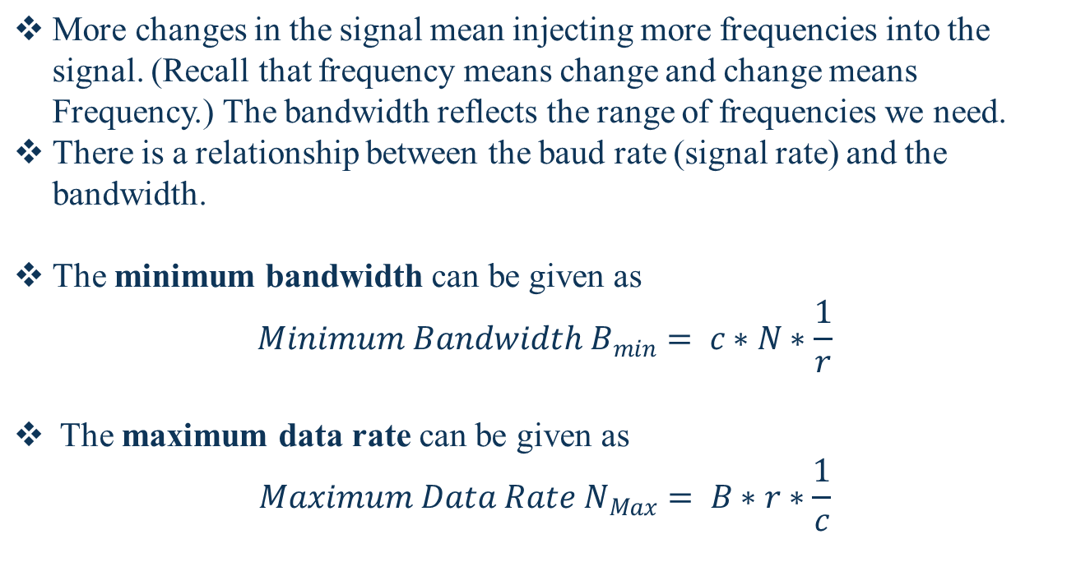
Signal Rate & Data Rate
[1] Data Communications and Networking: Behrouz Forouzan, 4th Edition.

Slide 32
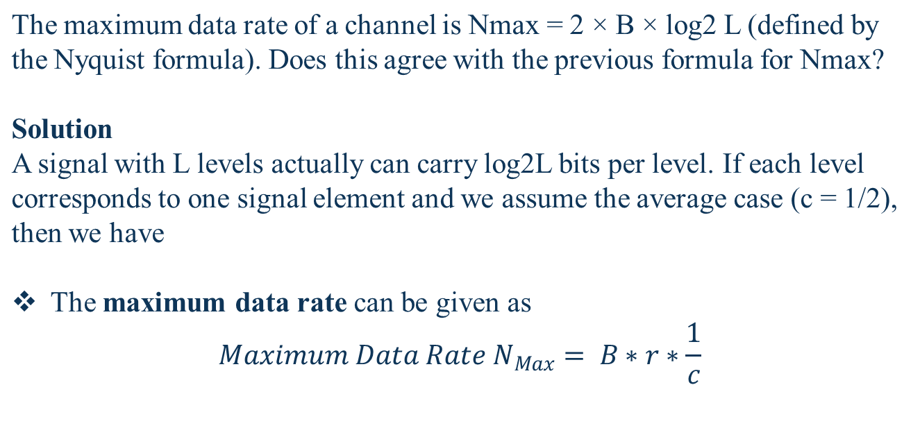

Signal Rate & Data Rate
[1] Data Communications and Networking: Behrouz Forouzan, 4th Edition.

Slide 33

Characteristics
A self-synchronizing digital signal includes timing information in the data being transmitted. This can be achieved if there are transitions in the signal that alert the receiver to the beginning, middle, or end of the pulse. If the receiver's clock is out of synchronization, these points can reset the clock.
[1] Data Communications and Networking: Behrouz Forouzan, 4th Edition.

Slide 34
Characteristics
To correctly interpret the signals received from the sender, the receiver's bit intervals must correspond exactly to the sender's bit intervals. If the receiver clock is faster or slower, the bit intervals are not matched and the receiver might misinterpret the signals.
[1] Data Communications and Networking: Behrouz Forouzan, 4th Edition.

Slide 35
Characteristics
Built-in Error Detection: It is desirable to have a built-in error-detecting capability in the generated code to detect some of or all the errors that occurred during transmission.
Immunity to Noise and Interference : Another desirable code characteristic is a code is that is immune to noise and other interferences.
Complexity: A complex scheme is more costly to implement than a simple one. For example, a scheme that uses four signal levels is more difficult to interpret than one that uses only two levels
[1] Data Communications and Networking: Behrouz Forouzan, 4th Edition.

Slide 36

Line Coding Schemes
[1] Data Communications and Networking: Behrouz Forouzan, 4th Edition.

Slide 37

Unipolar NRZ Scheme
In a unipolar scheme, all the signal levels are on one side of the time axis, either above or below.
NRZ (Non-Return-to-Zero) scheme in which the positive voltage defines bit 1 and the zero voltage defines bit 0. It is called NRZ because the signal does not return to zero at the middle of the bit.
[1] Data Communications and Networking: Behrouz Forouzan, 4th Edition.

Slide 38

Polar NRZ scheme
In polar schemes, the voltages are on the both sides of the time axis. For example, the voltage level for 0 can be positive and the voltage level for I can be negative.
NRZ (Non-Return-to-Zero) scheme in which we use two levels of voltage amplitude. We can have two versions of polar NRZ: NRZ-Land NRZ-I.
In NRZ-L the level of the voltage determines the value of the bit.
In NRZ-I the inversion or the lack of inversion determines the value of the
bit.
For NRZ-L(NRZ-Level), the level of the voltage determines the value of the bit, typically binary 1 maps to logic-level high, and binary 0 maps to logic-level low, and for NRZ-I(NRZ-Invert), two-level signal has a transition at a boundary if the next bit that we are going to transmit is a logical 1, and does not have a transition if the next bit that we are going to transmit is a logical 0. Note – For NRZ-I we are assuming in the example that previous signal before starting of data set “01001110” was positive. Therefore, there is no transition at the beginning and first bit “0” in current data set “01001110” is starting from +V. Example: Data = 01001110.
[1] Data Communications and Networking: Behrouz Forouzan, 4th Edition.

Slide 39
For NRZ-L(NRZ-Level), the level of the voltage determines the value of the bit, typically binary 1 maps to logic-level high, and binary 0 maps to logic-level low, and for NRZ-I(NRZ-Invert), two-level signal has a transition at a boundary if the next bit that we are going to transmit is a logical 1, and does not have a transition if the next bit that we are going to transmit is a logical 0.
Note – For NRZ-I we are assuming in the example that previous signal before starting of data set “01001110” was positive. Therefore, there is no transition at the beginning and first bit “0” in current data set “01001110” is starting from +V. Example: Data = 01001110.

Slide 40

Line Coding Schemes: Polar RZ scheme
[1] Data Communications and Networking: Behrouz Forouzan, 4th Edition.

Slide 41

Line Coding Schemes: Polar Biphase scheme
[1] Data Communications and Networking: Behrouz Forouzan, 4th Edition.

Slide 42

Bipolar scheme: AMI and pseudoternary
[1] Data Communications and Networking: Behrouz Forouzan, 4th Edition.

Slide 43


Multilevel mBnL: 2B1Q scheme
m = data elements
B = binary data
n = length of signal pattern
L = number of levels in signal
[1] Data Communications and Networking: Behrouz Forouzan, 4th Edition.

Slide 44

Multilevel: 8B6T scheme
[1] Data Communications and Networking: Behrouz Forouzan, 4th Edition.

Slide 45

Multilevel: 4D-PAM5 scheme
[1] Data Communications and Networking: Behrouz Forouzan, 4th Edition.

Slide 46

Multitransition: MLT-3 scheme
[1] Data Communications and Networking: Behrouz Forouzan, 4th Edition.

Slide 47

Summary
[1] Data Communications and Networking: Behrouz Forouzan, 4th Edition.

Slide 48

Block Coding
Block coding is normally referred to as mB/nB coding; it replaces each m-bit group with an n-bit group.
[1] Data Communications and Networking: Behrouz Forouzan, 4th Edition.

Slide 49

Block Coding
Block coding is normally referred to as mB/nB coding; it replaces each m-bit group with an n-bit group.
[1] Data Communications and Networking: Behrouz Forouzan, 4th Edition.

Slide 50

Block Coding: 4B/5B Mapping
[1] Data Communications and Networking: Behrouz Forouzan, 4th Edition.

Slide 51
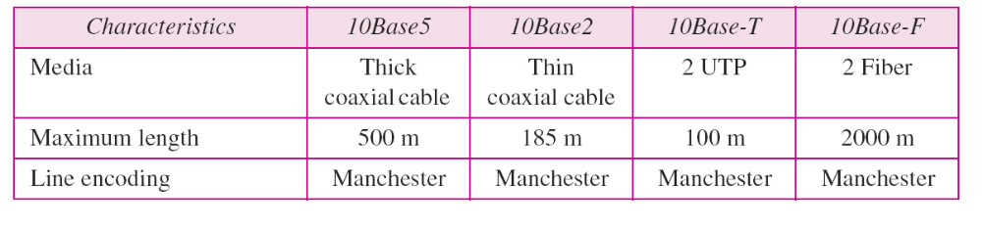
Summary of Line Coding
[1] Data Communications and Networking: Behrouz Forouzan, 4th Edition.

Slide 52
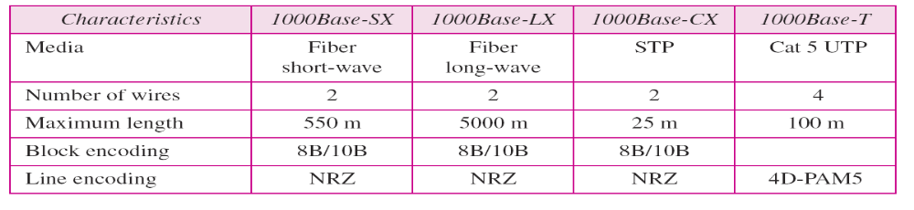
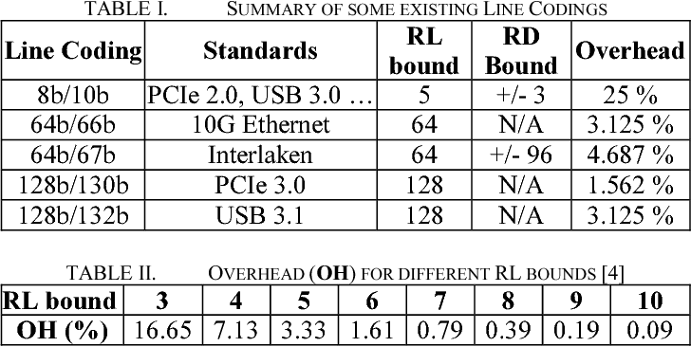
Summary of Line Coding
[2] https://en.wikipedia.org/wiki/IEEE_802

Slide 53

Digital-to-analog conversion
Digital-to-analog conversion is the process of changing one of the characteristics of an analog signal based on the information in digital data.
[1] Data Communications and Networking: Behrouz Forouzan, 4th Edition.

Slide 54

Types of Digital-to-analog conversion
[1] Data Communications and Networking: Behrouz Forouzan, 4th Edition.

Slide 55

Amplitude Shift Keying
In ASK, amplitude of the carrier signal is changes as per the information signal.
ASK is usually implemented with two voltage levels so known as On-off keying (OOK).
Bandwidth of ASK Signal: B = (1 + d) * S
Where, d = Modulation and filtering factor values ranges from 0 to 1.
S = Signal Rate.
[1] Data Communications and Networking: Behrouz Forouzan, 4th Edition.

Slide 56

Implementation of Binary ASK
[1] Data Communications and Networking: Behrouz Forouzan, 4th Edition.

Slide 57

Multi-level ASK
In data communications, we normally use full-duplex links with communication in both directions. We need to divide the bandwidth into two with two carrier frequencies, as shown in Figure. The figure shows the positions of two carrier frequencies and the bandwidths. The available bandwidth for each direction is now 50 kHz, which leaves us with a data rate of 25 kbps in each direction.
[1] Data Communications and Networking: Behrouz Forouzan, 4th Edition.

Slide 58

Binary Frequency Shift Keying
In FSK, Frequency of the carrier signal is changes as per the information signal.
FSK is usually implemented with two carrier frequencies.
Bandwidth of FSK Signal: B = (1 + d) * S + 2∆f
Where, d = Modulation and filtering factor values ranges from 0 to 1.
S = Signal Rate.
[1] Data Communications and Networking: Behrouz Forouzan, 4th Edition.

Slide 59

Implementation of Binary Frequency Shift Keying
Implementation:
Coherent: Phase remains continuous at boundary of two signal elements.
Non-coherent: Phase discontinuity when one signal elements ends.
[1] Data Communications and Networking: Behrouz Forouzan, 4th Edition.

Slide 60

Implementation of Binary Frequency Shift Keying
We need to send data 3 bits at a time at a bit rate of 3 Mbps. The carrier frequency is 10 MHz. Calculate the number of levels (different frequencies), the baud rate, and the bandwidth.
Solution
We can have L = 23 = 8. The baud rate is S = 3 MHz/3 = 1000 Mbaud. This means that the carrier frequencies must be 1 MHz apart (2Δf = 1 MHz). The bandwidth is B = 8 × 1000 = 8000. Figure 5.8 shows the allocation of frequencies and bandwidth.
B = (1 + d) * S + (L-1) 2∆f = L*S
[1] Data Communications and Networking: Behrouz Forouzan, 4th Edition.

Slide 61

Binary Phase Shift Keying
In PSK, Phase of the carrier signal is changes as per the information signal.
PSK is usually implemented with one carrier frequency.
Bandwidth of PSK Signal: B = (1 + d) * S
PSK is less susceptible to noise in comparison to ASK and less bandwidth then FSK as only carrier frequency will be required.
[1] Data Communications and Networking: Behrouz Forouzan, 4th Edition.

Slide 62

Implementation of Binary Phase Shift Keying
[1] Data Communications and Networking: Behrouz Forouzan, 4th Edition.

Slide 63

Quadrature Phase Shift Keying
[1] Data Communications and Networking: Behrouz Forouzan, 4th Edition.

Slide 64

Constellation Diagram: Quadrature Phase Shift Keying
[1] Data Communications and Networking: Behrouz Forouzan, 4th Edition.

Slide 65

Constellation Diagram: Quadrature Phase Shift Keying
[1] Data Communications and Networking: Behrouz Forouzan, 4th Edition.

Slide 66

Quadrature Amplitude Modulation
Quadrature amplitude modulation is a combination of ASK and PSK.
[1] Data Communications and Networking: Behrouz Forouzan, 4th Edition.

Slide 67


Repository
http://highered.mheducation.com/sites/0072967757/information_center_view0/index.html
http://authors.phptr.com/tanenbaumcn4/
http://nptel.ac.in/courses/106105081

